Slide 1
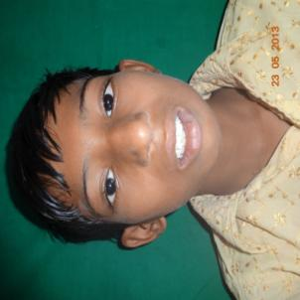
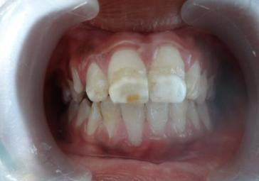
1.MOLAR INCISOR HYPOMINERALIZATION –REHABILATATION
PRE OPERATIVE
Extra oral photograph
Hypomineralized teeth irt 11,21

Slide 2
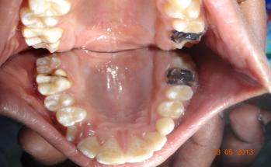
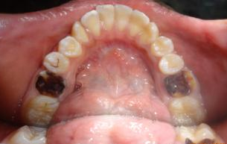
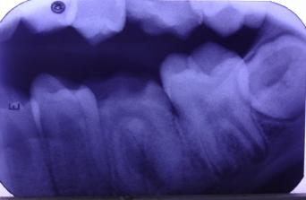
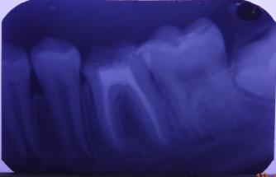
Hypomineralized teeth irt 16,26,36,46
Pre operative 36
post operative 36

Slide 3
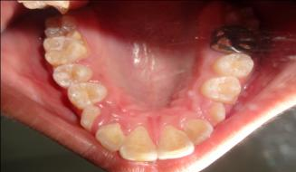
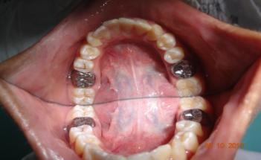
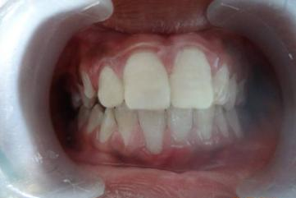
Post opearative photograph showing SS crowns irt 26,36,46
GIC restoration irt 16
Composite restoration irt 11,21

Slide 4


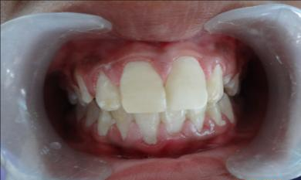
FOLLWUP AFTER 1 MONTH

Slide 5
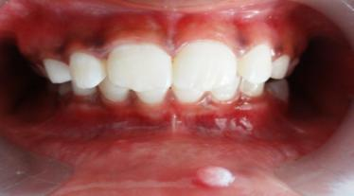
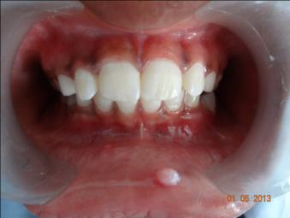
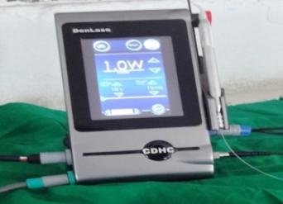
2.REHABILITATION OF A CHILD WITH SELF INFLICTING INJURY
Composite restoration irt 11,21
Diode Laser

Slide 6
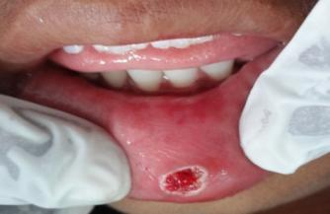
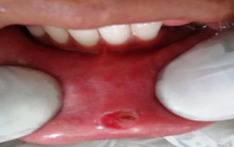
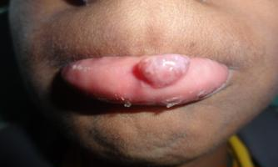
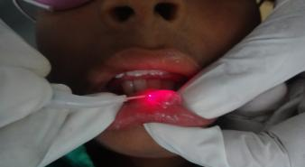
Post operative after excision
with Laser
Follow up after 1 week
Recurrence of the lesion
Treated with diode laser

Slide 7
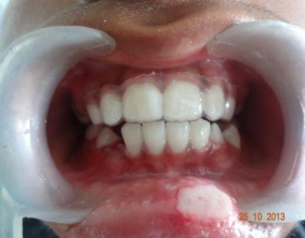
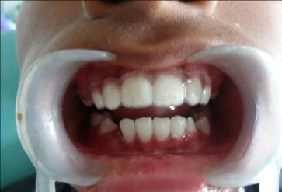
Thermoplastisized splint
placement
Follow up after 4 months

Slide 8
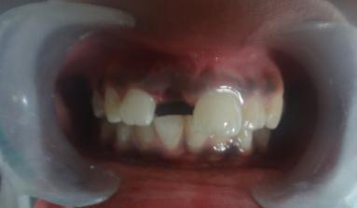
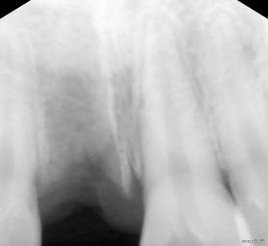
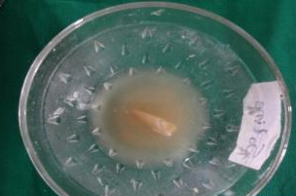
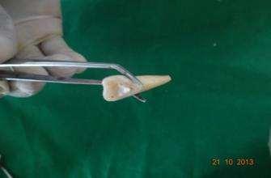
3.REPLANTATION OF AVULSED TEETH
PRE OPERATIVE
Ellis Class V Fracture irt 11
IOPA irt 11
Avulsed teeth in doxycycline solution
Extra oral RCT irt 11

Slide 9
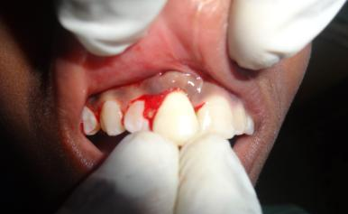
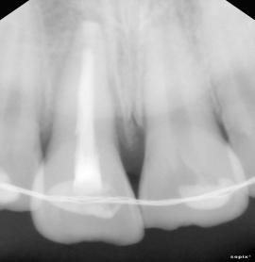
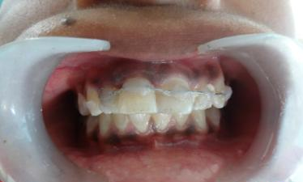
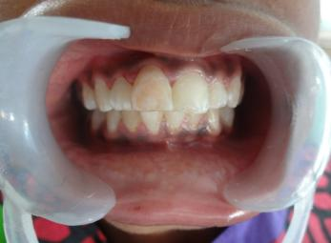
Replantation of avulsed teeth
Radiograph on the day of
replantation
Composite wire splining irt 11
After splint removal

Slide 10
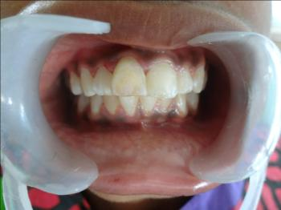
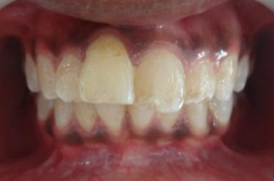
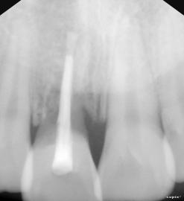
Follow up after 6 months
Follow up after 2 years
Clinical
Radiographical

Slide 11
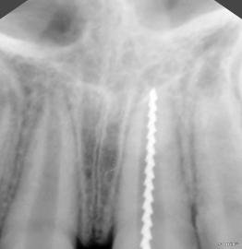
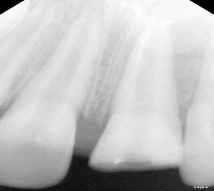
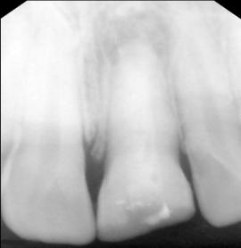

4.APEXIFICATION
Pre operative IOPA-21
Working length irt 21
Immediately after placing
calcium hydroxide
6 months follow up

Slide 12
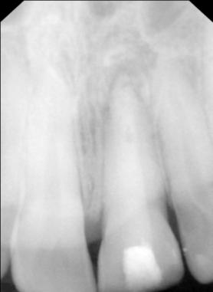
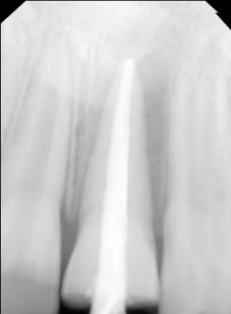
Osseo cementum barrier
seen irt 21
Obturation done after
12 months

Slide 13
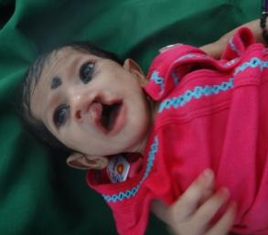
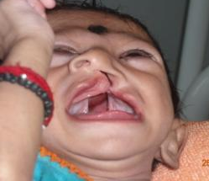
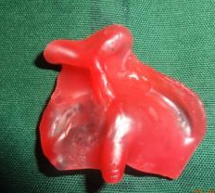
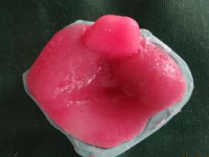
5.FEEDING PLATE FOR CLEFT LIP AND PALATE
PRE OPERATIVE PHOTOGRAPHS
Extra oral view
Intra oral view
LAB PROCEDURES
Primary impression
With modelling wax
Primary cast with
Special tray

Slide 14
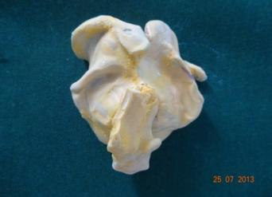
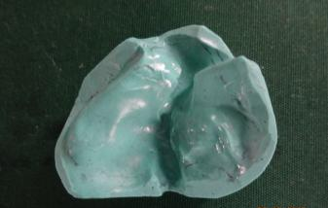
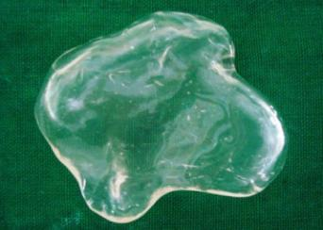
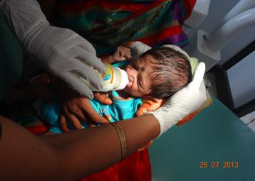
Secondary impression
with putty
Secondary cast
Feeding plate made with
Thermoplastic material
Feeding the baby with
feeding plate

Slide 15
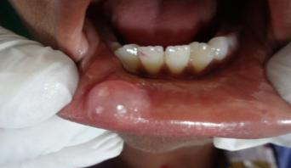
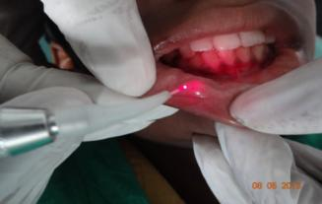
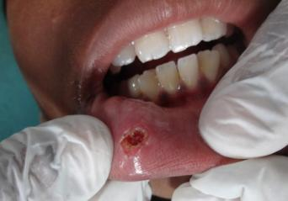
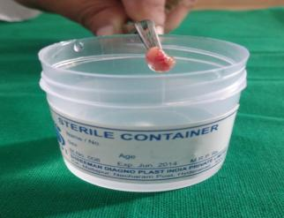
6.LASER EXCISION OF MUCOCELE
Mucocele on lower lip
Mucocele by laser excision
Immediately after excision
Excisied tissue

Slide 16
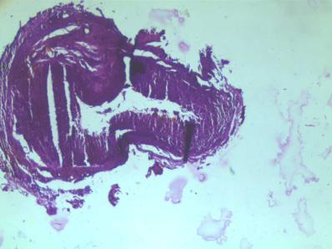
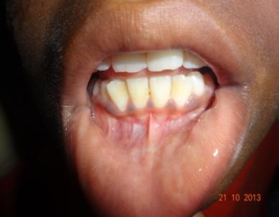
Histopathology picture
Followup after 6 months

Slide 17
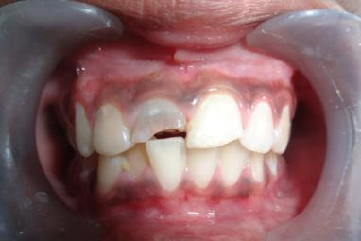

7.MANAGEMENT OF SEVERELY MUTILATED TOOTH
BY POST AND CORE
PRE OPERATIVE
Intra oral photograph showing
Ellis class iv fracture irt 11
IOPA irt 11

Slide 18



RCT irt 11,12
Metal post irt 11

Slide 19


Core buildup with composite
Post operative intra oral photograph
Showing PFM crown irt 11

Slide 20




8.COMPOSITE WIRE SPLINTING
PRE OPERATIVE
Extra oral photograph
Intra oral photographs
Arches in occlusion showing
fractured 11,21

Slide 21



IOPA irt 11 and 21 showing Ellis class ii # irt 11
And Ellis class iii # irt 21
Composite wire splinting done irt 11,12,13,21,22,23

Slide 22


RC treated tooth irt 11,21
composite restored teeth irt 11 and
polycarbonate crown cementation irt 21

Slide 23



9.LASER EXCISION OF MYOFIBROMA
Preoperative photograph
Preoperative OPG

Slide 24



After exicision
Excised lesion
Histopoathology picture

Slide 25




Follow up after 1 week
Recurrence of lesion after 1 month
Excision tumor enbloc with wedge
of mandible
Post operative OPG

Slide 26


10.PROSTHODONTIC REHABILITATION OF A CHILD WITH ECTODERMAL DYSPLASIA
PRE OPERATIVE
Extra oral view
Arches in occlusion

Slide 27



knife edge ridges
Radiographic appearence

Slide 28




preliminary impressions
final impressions
Maxilla mandibular relation
Dentures

Slide 29


Denture insertion
Aesthetics and confidence
restored

