Slide 1
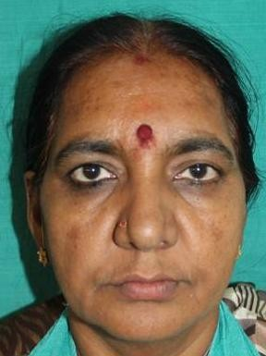
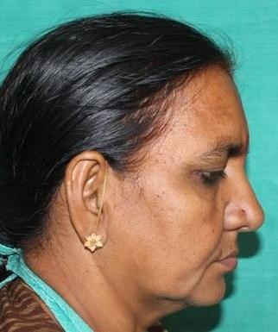
BALANCING COMPLETE DENTURE
PROFILE PHOTOGRAPHS

Slide 2
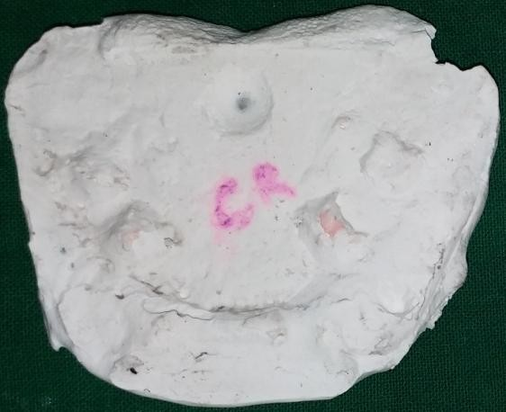
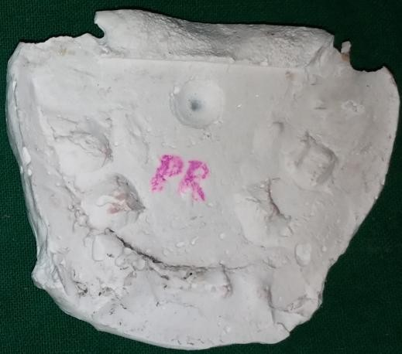
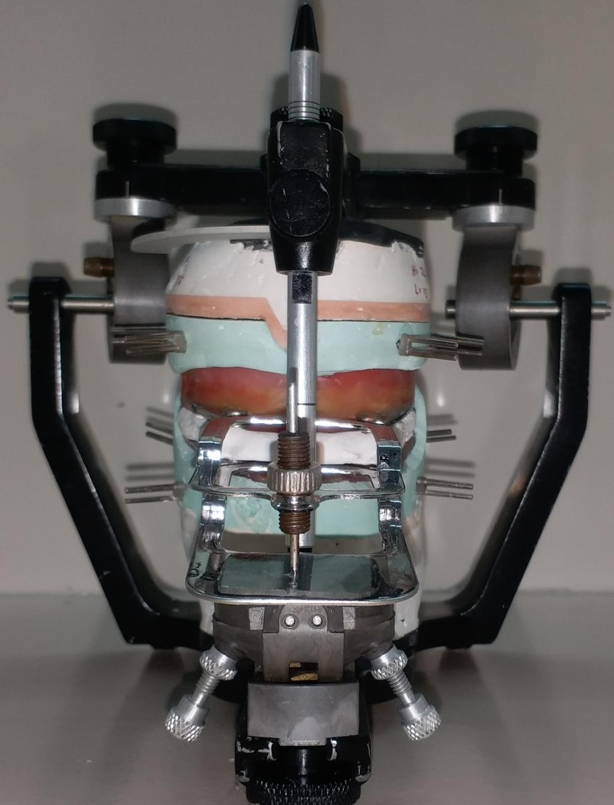
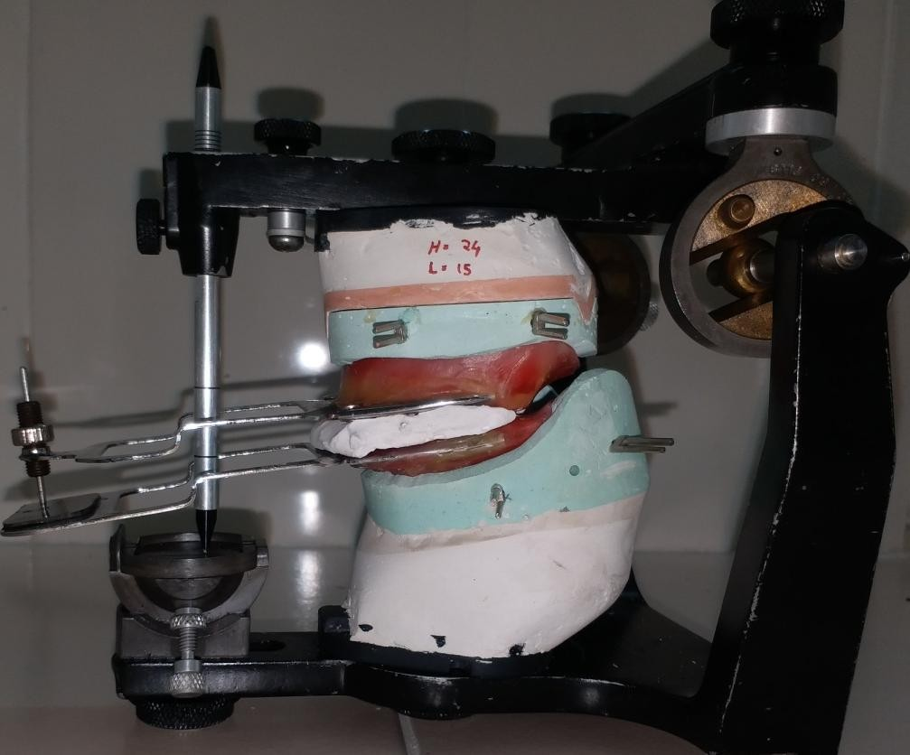
INTER OCCLUSAL RECORDS
PROGRAMMING THE ARTICULATOR

Slide 3
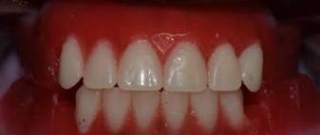
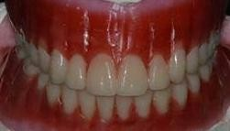
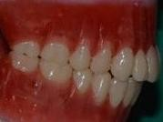
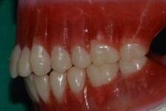
ANTERIOR WAX TRY IN
TEETH ARRANGEMENT:
FRONT VIEW
RIGHT LATERAL VIEW
LEFT LATERAL VIEW

Slide 4
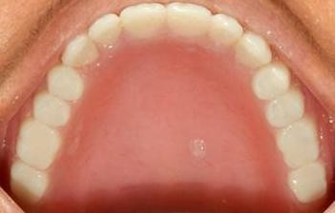
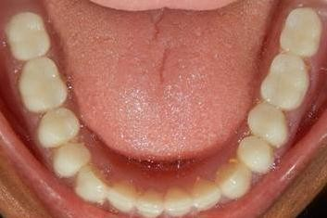
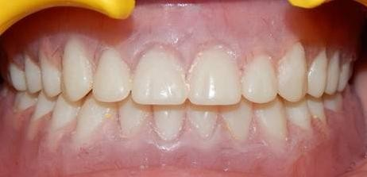
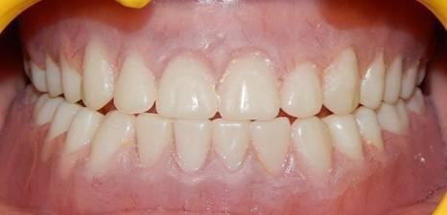
COMPLETE DENTURE INSERTION
CENTRIC OCCLUSION
PROTRUSIVE CONTACTS

Slide 5
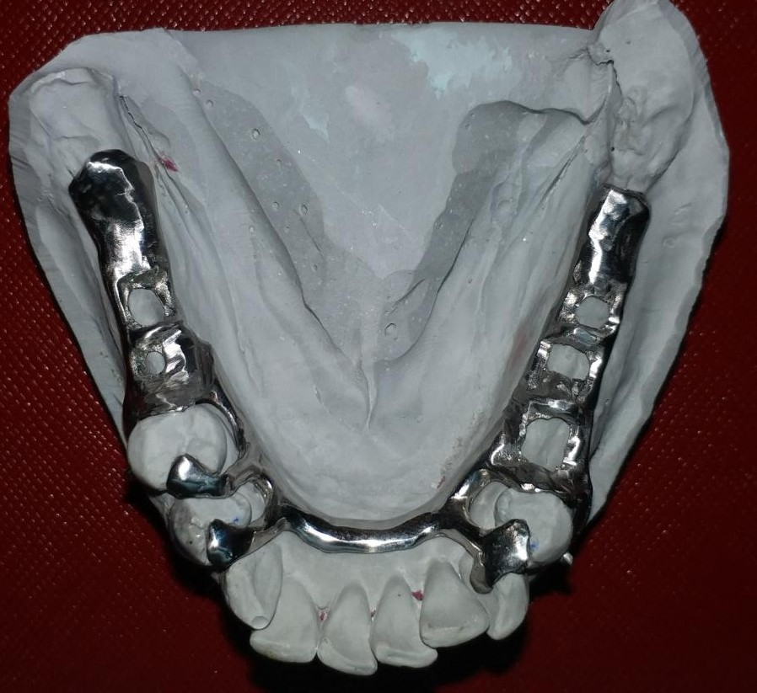
CAST PARTIAL DENTURE
CAST PARTIAL DENTURE FRAME WORK

Slide 6
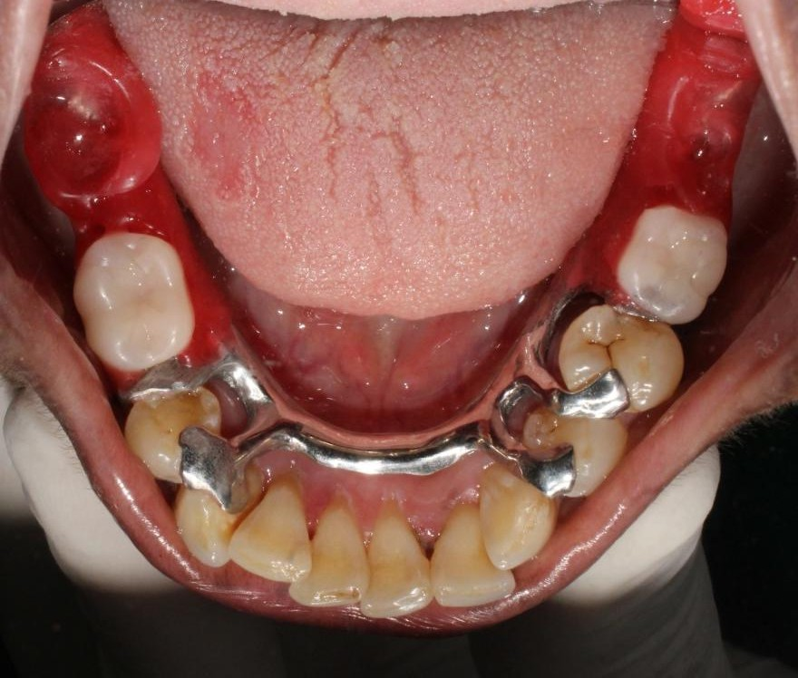
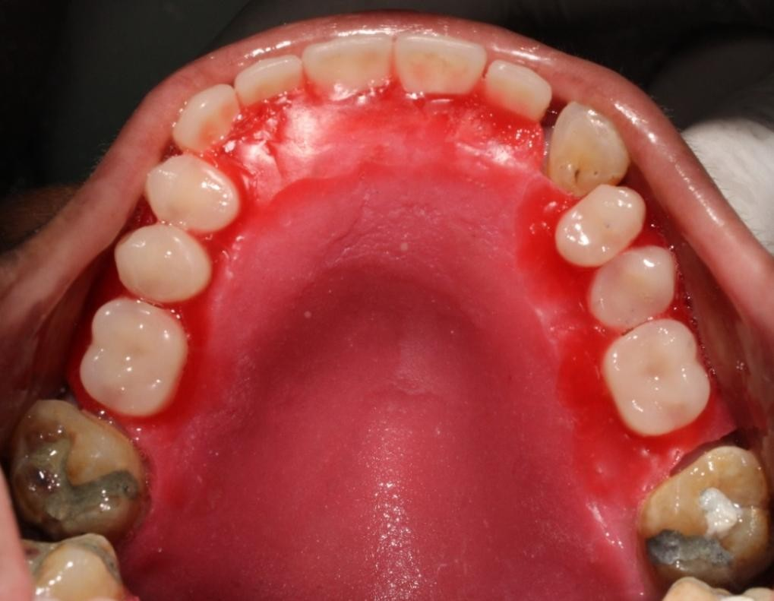
WAX TRY-IN CAST PARTIAL DENTURE

Slide 7
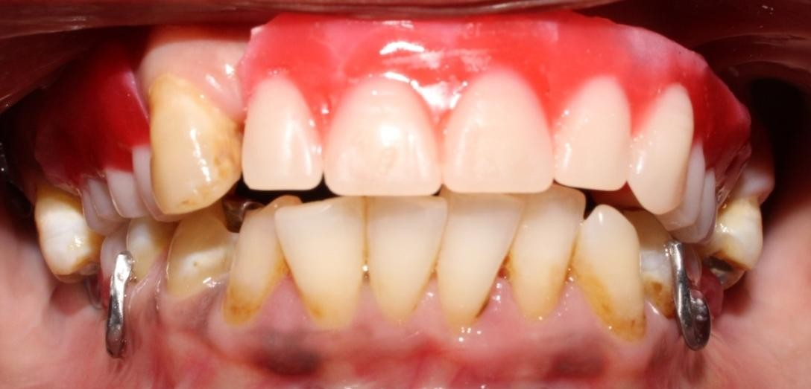
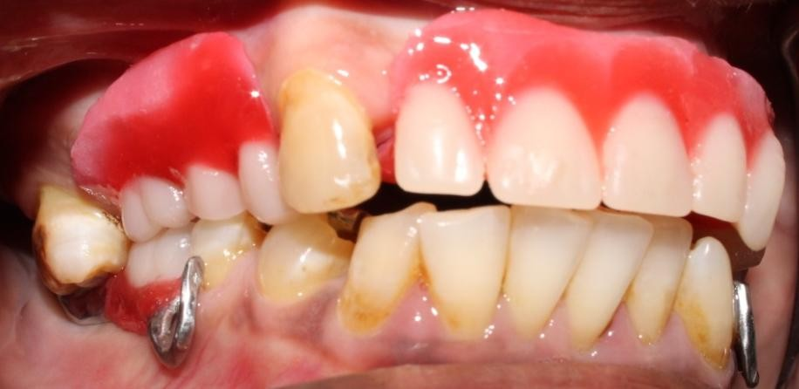
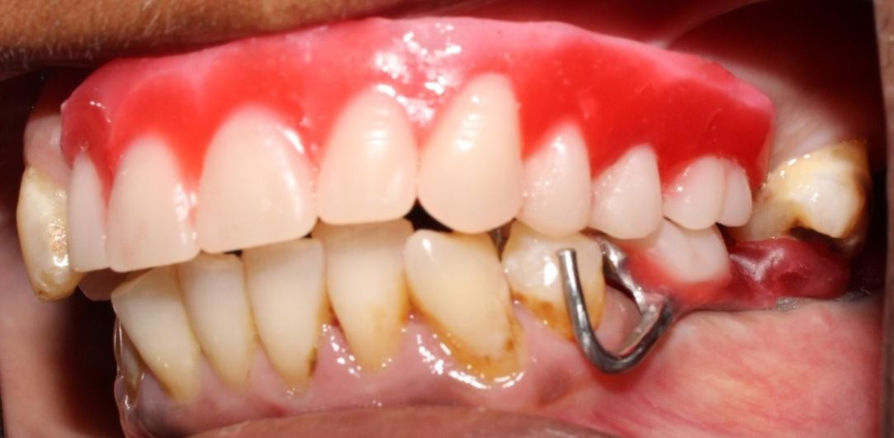
WAX TRY-IN CAST PARTIAL DENTURE

Slide 8
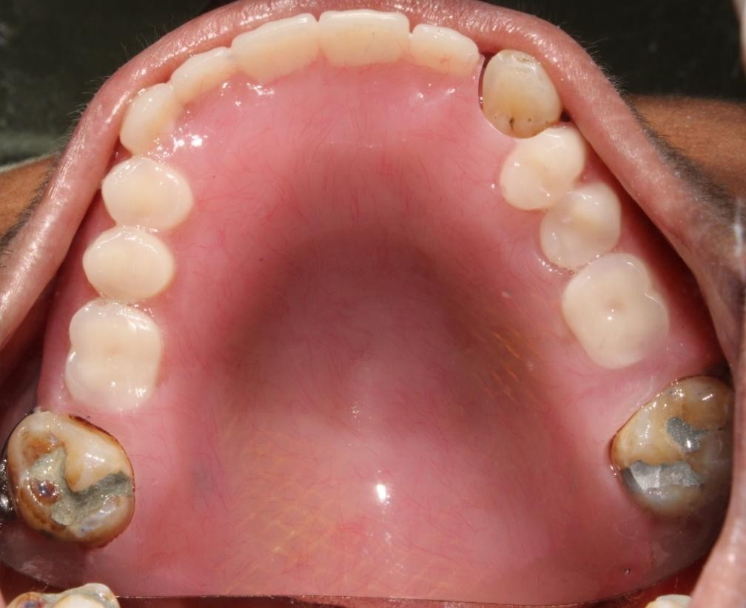
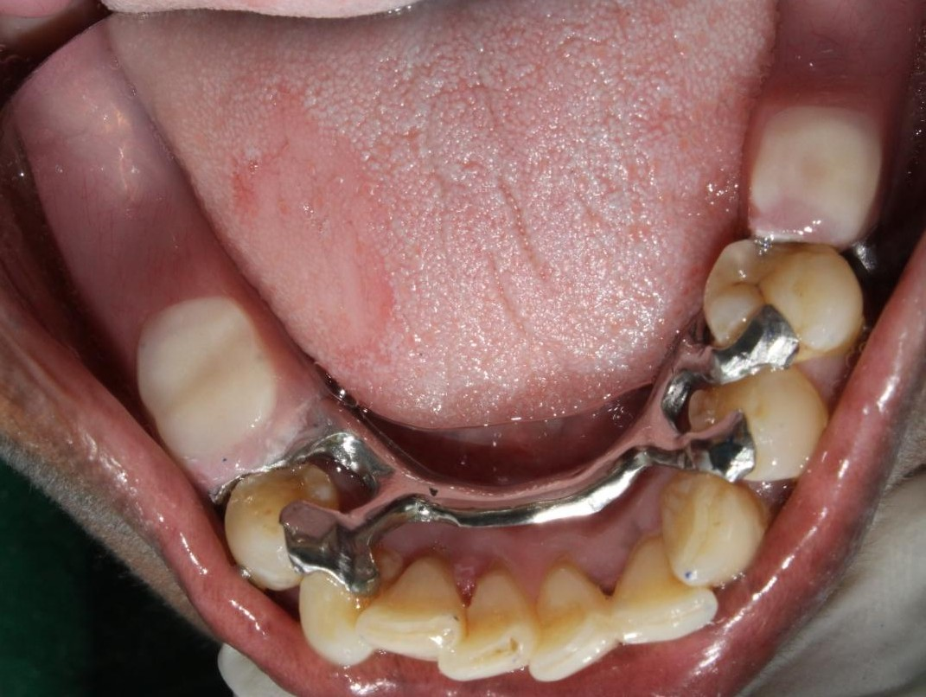
CAST PARTIAL DENTURE INSERTION DONE

Slide 9
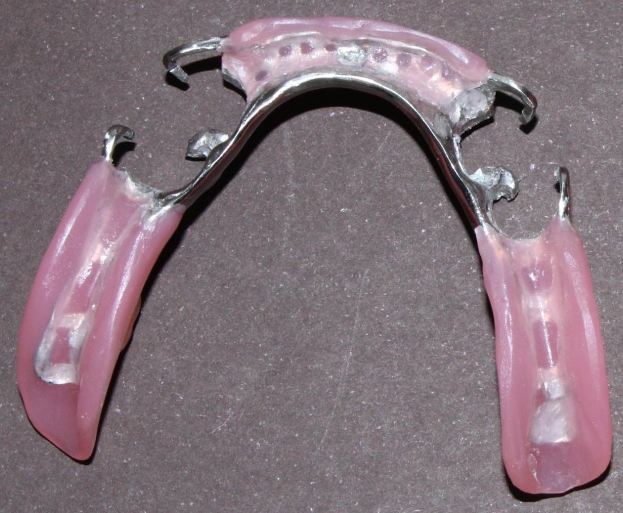
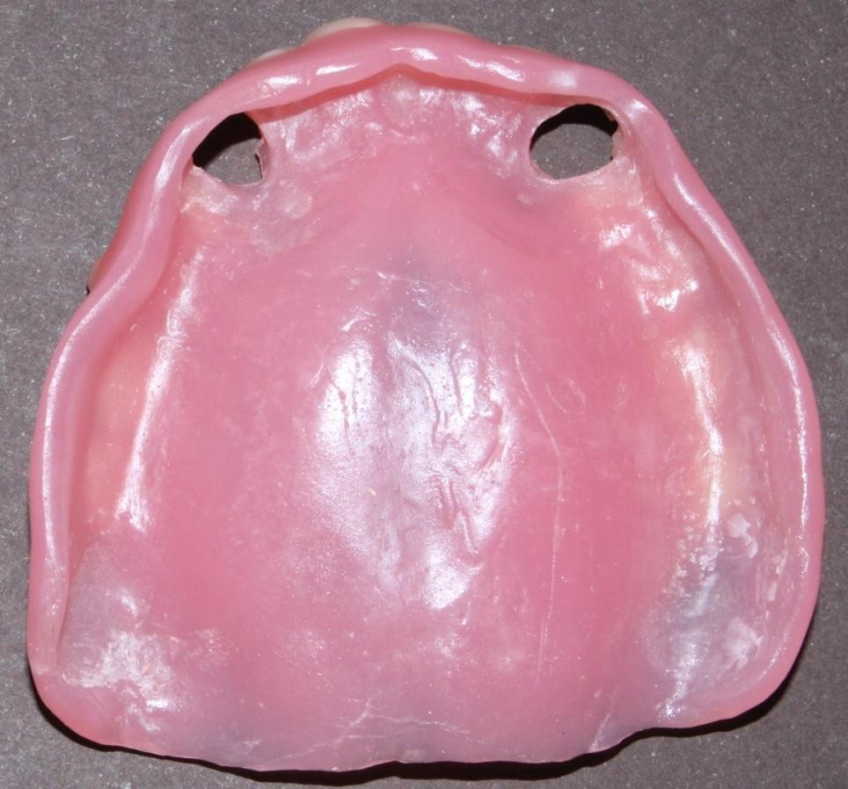
FINISHING AND POLISHING DONE

Slide 10
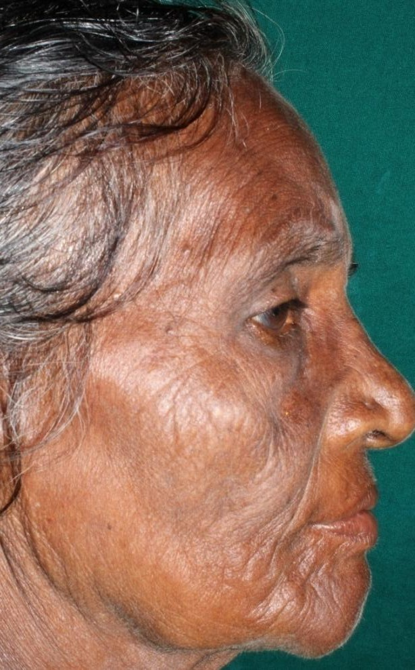
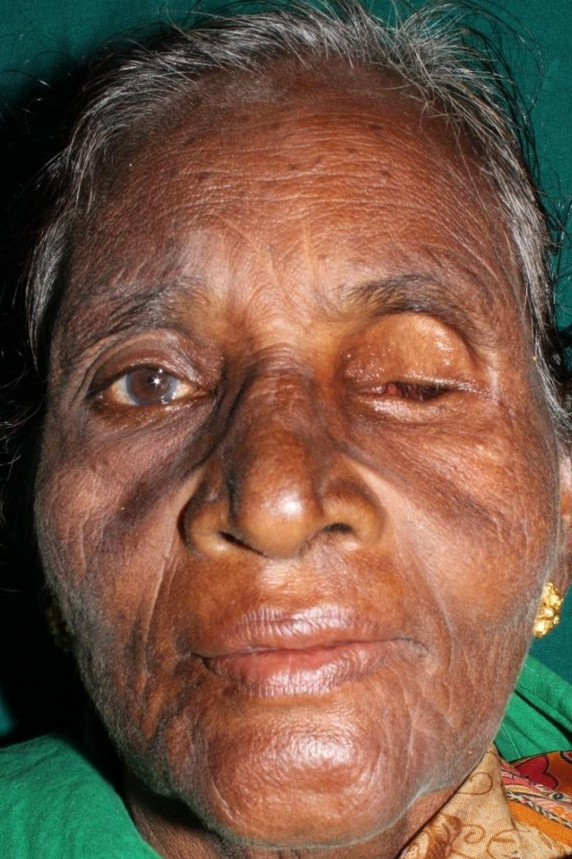
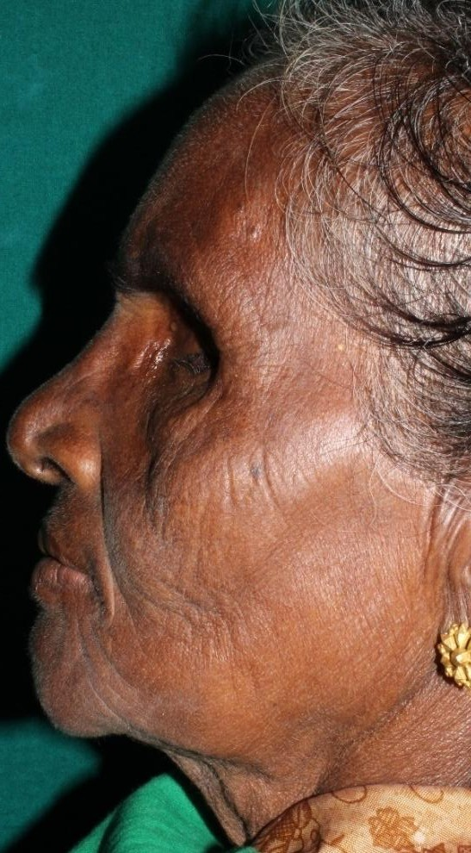
OCCULAR PROSTHESIS
RIGHT LATERAL PROFILE
PROFILE PHOTOGRAPH
LEFT LATERAL PROFILE

Slide 11
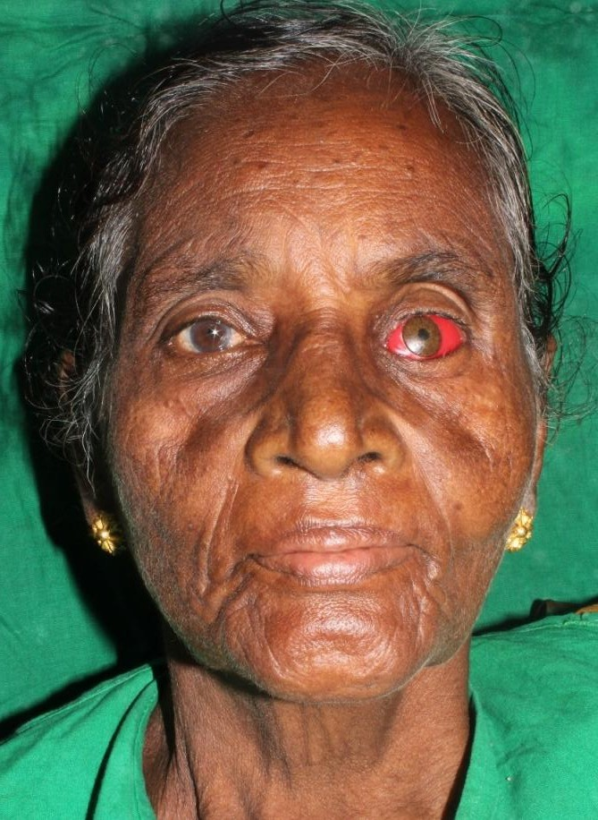
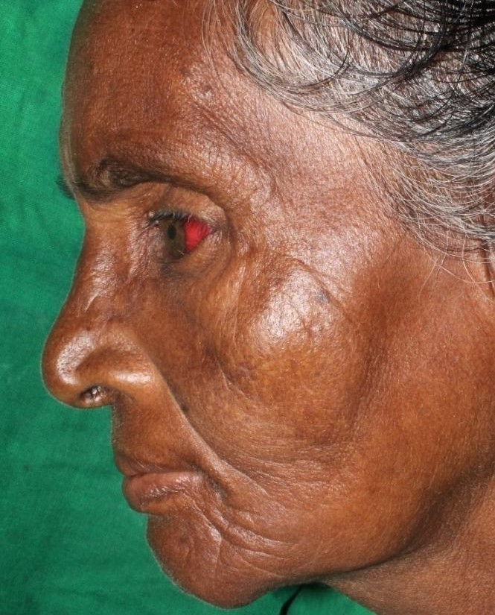
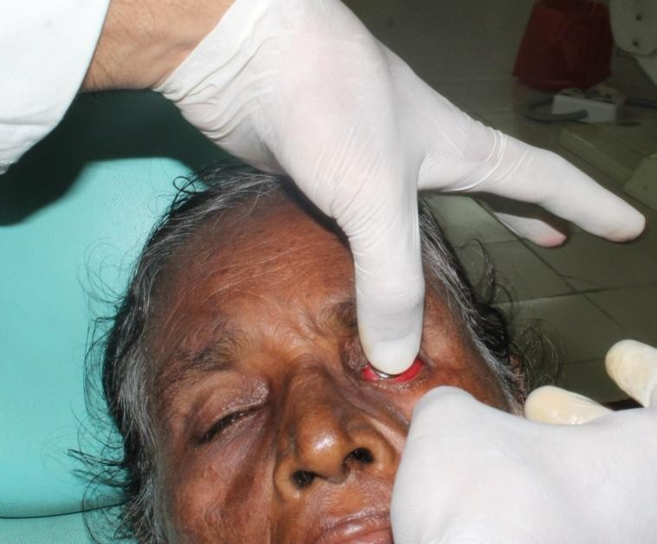
IRIS POSITIONING
LATERAL VIEW
FRONT VIEW

Slide 12

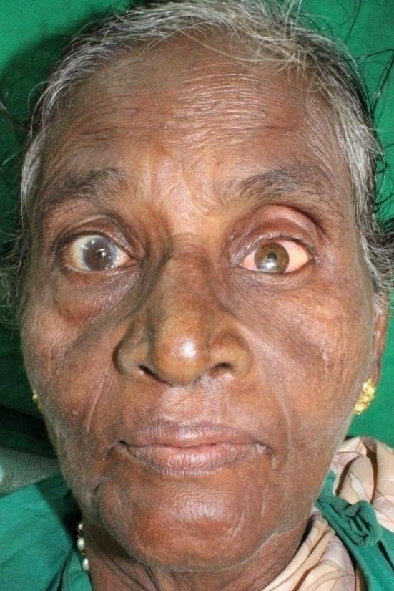
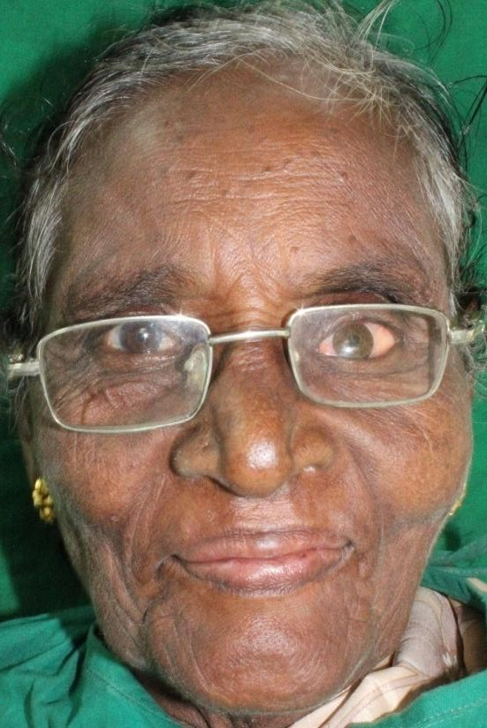
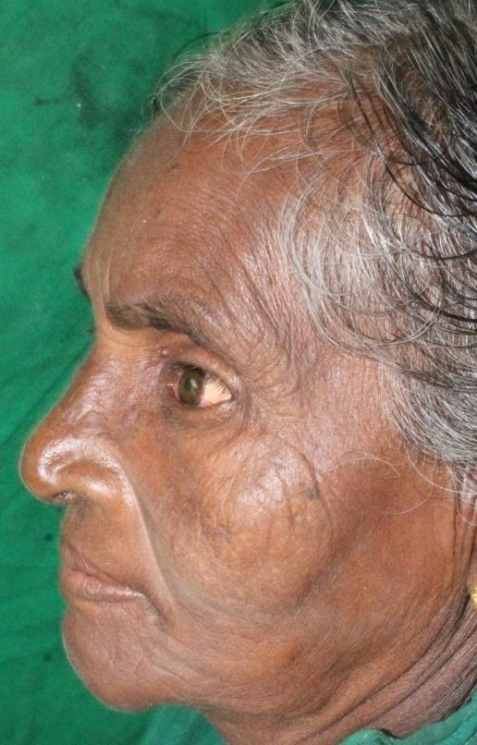
OCCLUAR PROSTHESIS INSERTION DONE

Slide 13
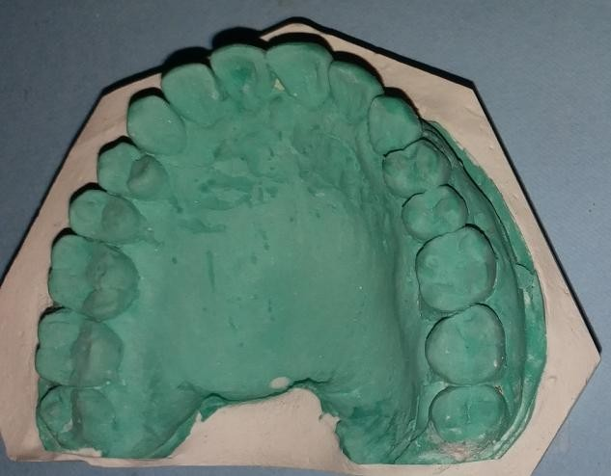
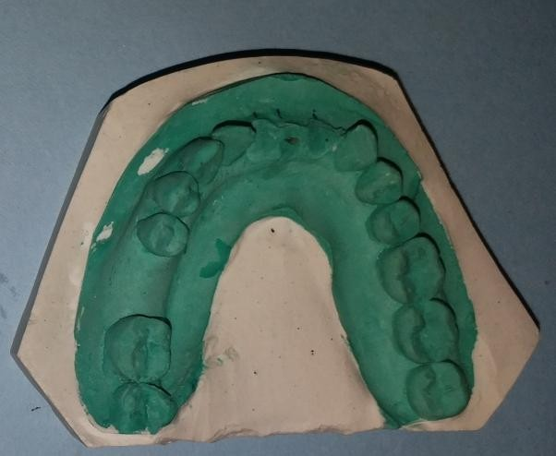
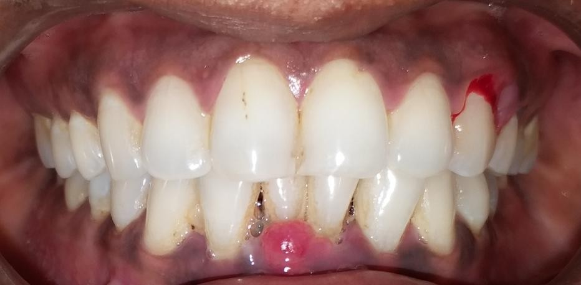
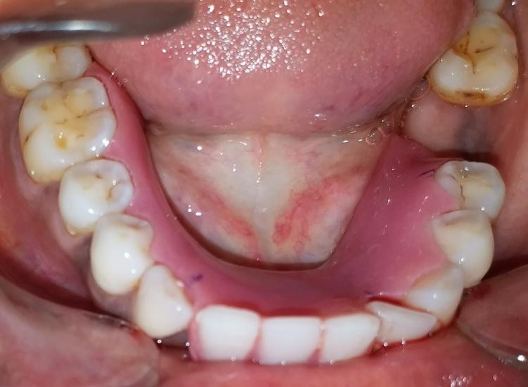
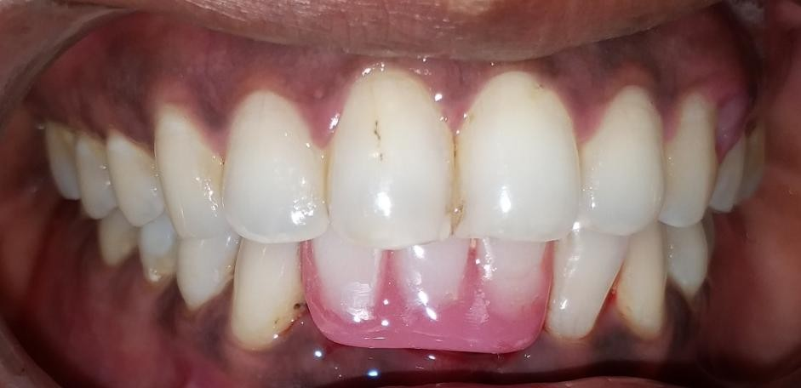
IMMEDIATE DENTURE
PRE-EXTRACTION INTRAORAL
PHOTOGRAPH
IMMEDIATE DENTURE INSERTION

Slide 14

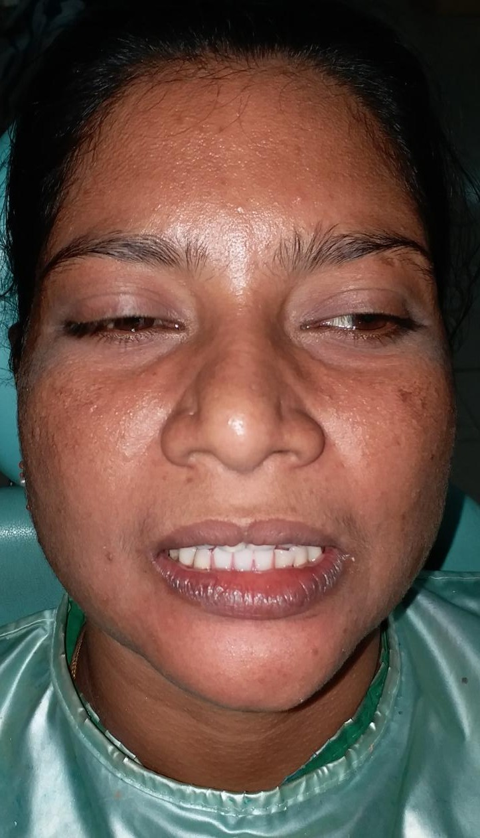
PRE-EXTRACTION
PHOTOGRAPH
IMMEDIATE DENTURE
INSERTION

Slide 15
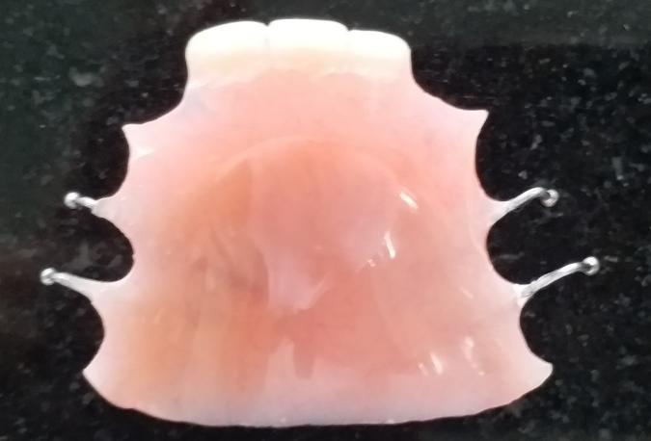
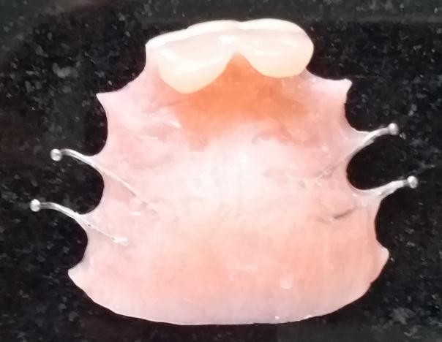
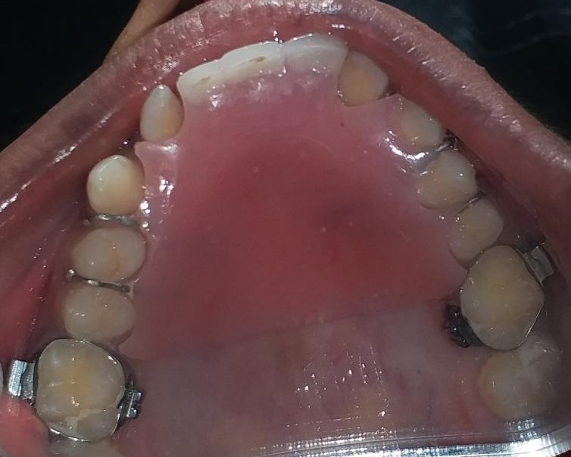
ANTERIOR BITE PLANE
FINISHING AND POLISHING DONE
INSERTION DONE

Slide 16
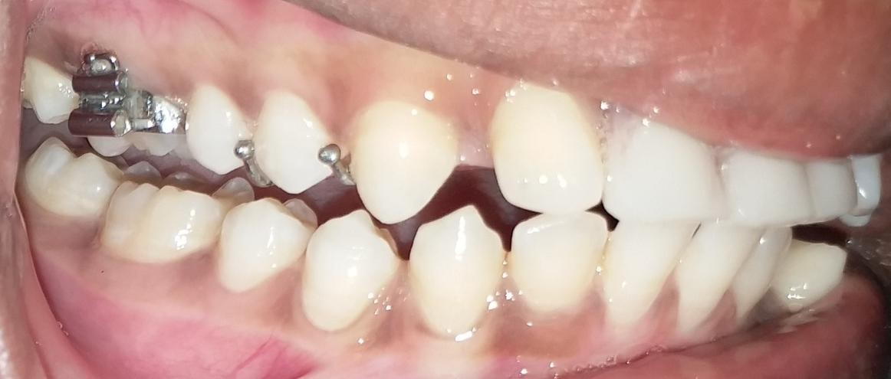
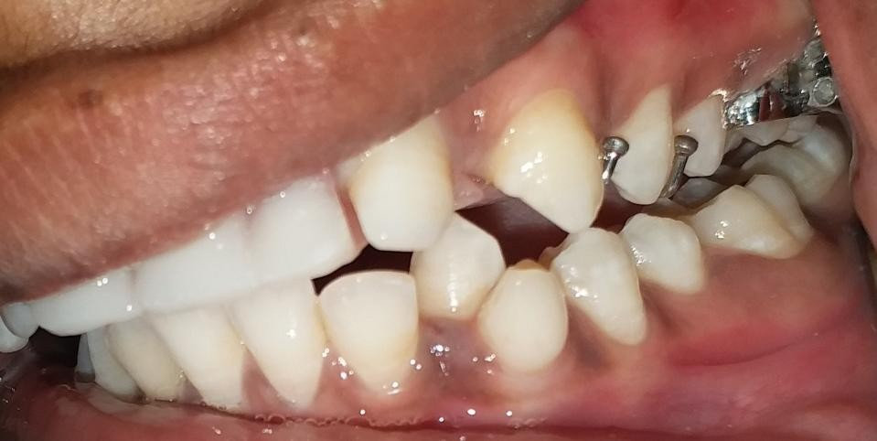
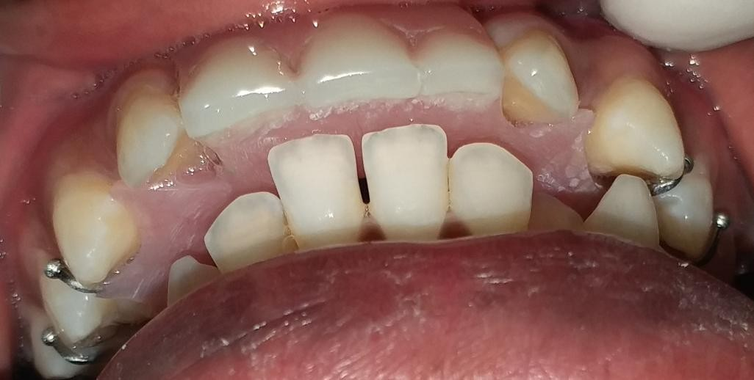
POSTERIOR DISOCCLUSION

Slide 17
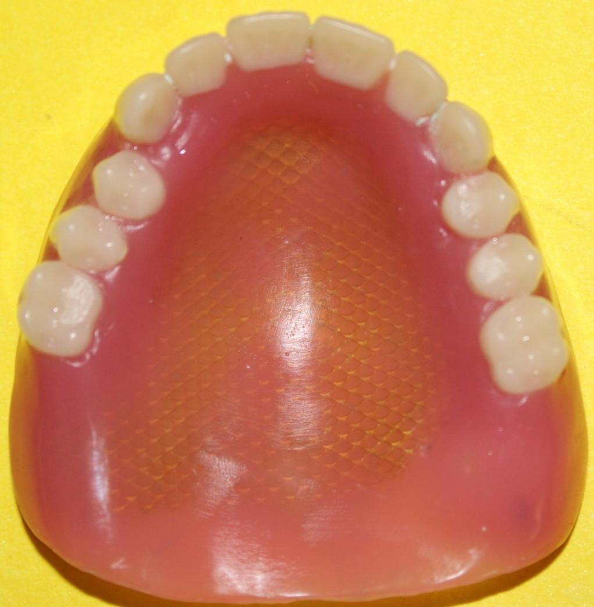
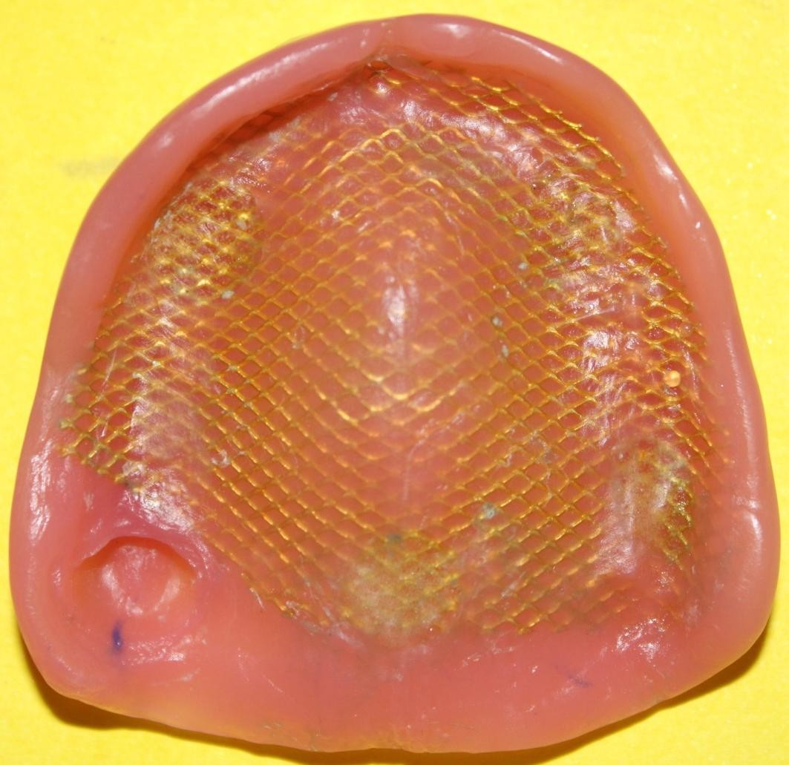
MESH REINFORCED SINGLE COMPLETE DENTURE
FINISHING AND POLISHING DONE

Slide 18
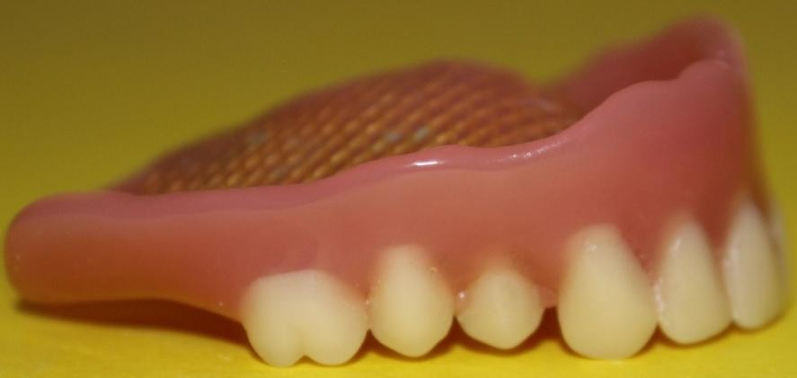
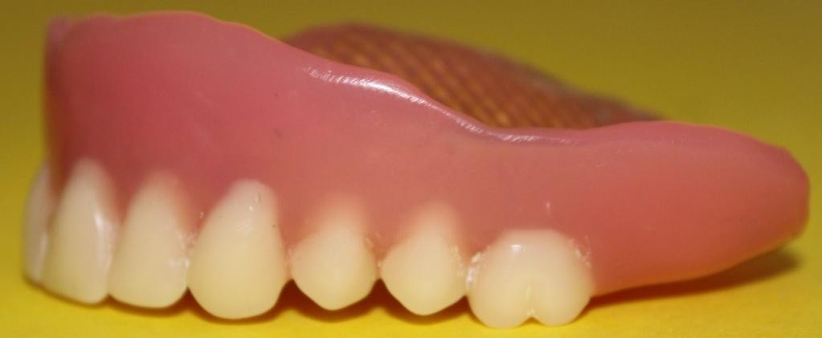
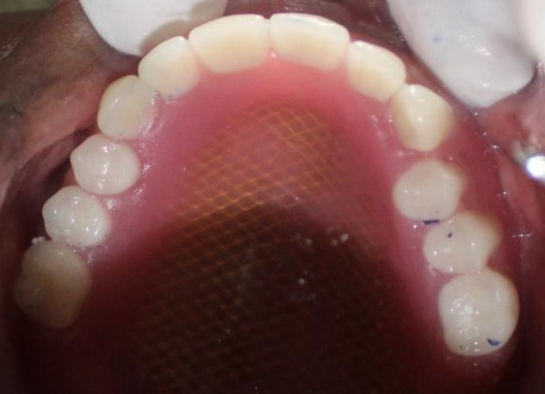



SINGLE COMPLETE DENTURE INSERTION
PROFILE
PHOTOGRAPH

Slide 19





TOOTH SUPPORTED OVERDENTURE
TOOTH PREPARATION
METAL COPINGS
PRIMARY IMPRESSION

Slide 20






FINISHING AND POLISHING DONE
TOOTH SUPPORTED OVERDENTURE INSERTION

Slide 21


PROFILE PHOTOGRAPHS

Slide 22






PRE OPERATIVE VIEW
POST OPERATIVE VIEW

